Slide 1
CAFEAM
A RETRO ACADE GAME

Slide 2
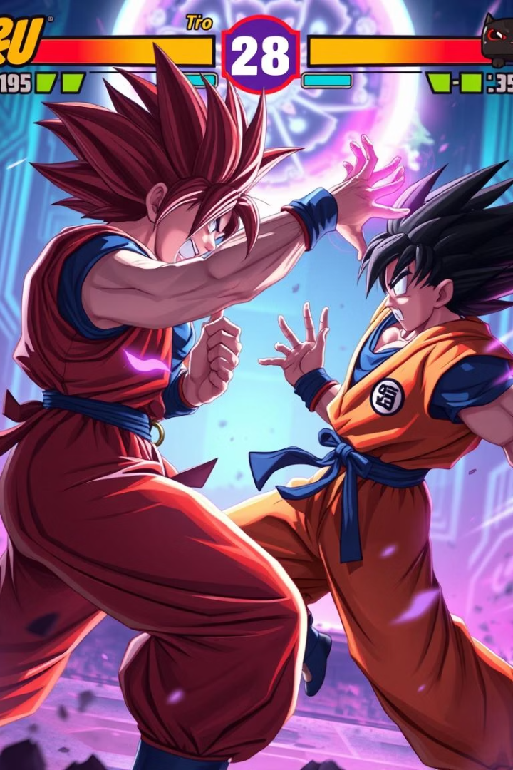
CAFEAM: A C++ Fighting Game with SFML
Introducing CAFEAM, a 2D fighting game developed in C++ using SFML.
This game emphasizes programming fundamentals and multimedia graphics.
Submitted by:
Hamza Imran
Hamza Mudassir
Hassan Ali
M.Soban Hussain

Slide 3
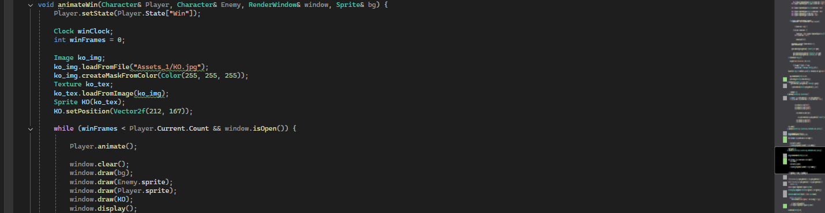
SFML Fundamentals: Graphics and Window Management
Basic Shapes & Textures
SFML Overview
Window Creation
Use sf::RenderWindow to display game visuals and interfaces.
Shapes such as sf::RectangleShape or sf::Sprite represent characters and environment.
Cross-platform multimedia library suited for 2D games and apps.

Slide 4
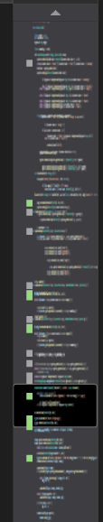
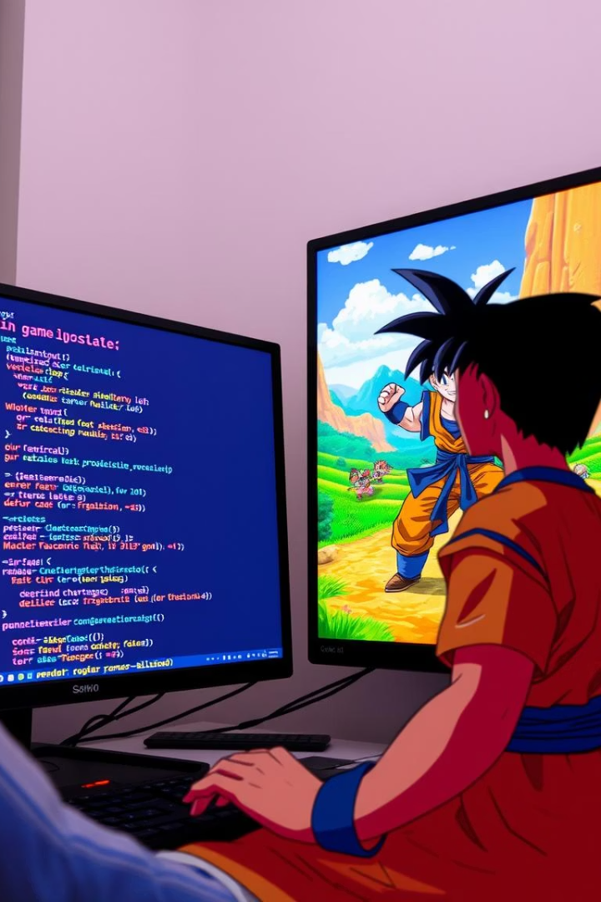



Game Loop: Heart of CAFEAM
Main Loop
Runs continuously while the window remains
open.
Event Handling
Processes keyboard inputs and window events
efficiently.
Update & Render
Updates game state then draws updated graphics
each frame.

Slide 5
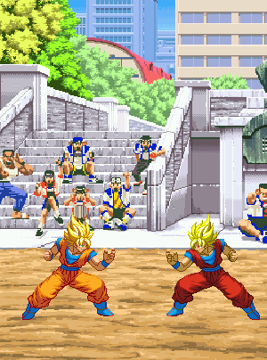
Character Movement: The Move Function
Movement Input
Keyboard controls move characters with `move(float x, float y)`.
Velocity & Acceleration
Apply forces for smooth and realistic motion.
Animation Frames
Switch sprites to create walking and motion effects.

Slide 6
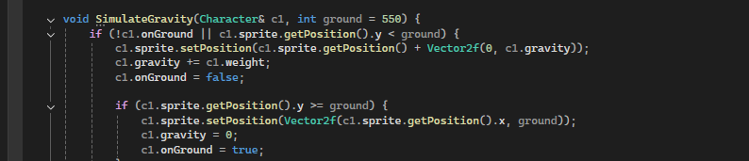

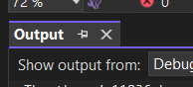
Simulate Gravity
Gravity Force
Jump Implementation
Collision Detection
Apply constant downward acceleration on characters.
Introduce upward force triggered by player input.
Bounding boxes detect ground contact to stop free fall.

Slide 7
Additional concepts used:
String Stream
Unordered Maps
A stream class for reading and parsing strings like file input, used here to extract state information (name, coordinates, frame count) from a line of text in the character data file.
An associative container that stores key-value pairs with fast average-case lookup, used here to map animation state names to their corresponding frame data for the character.

Slide 8
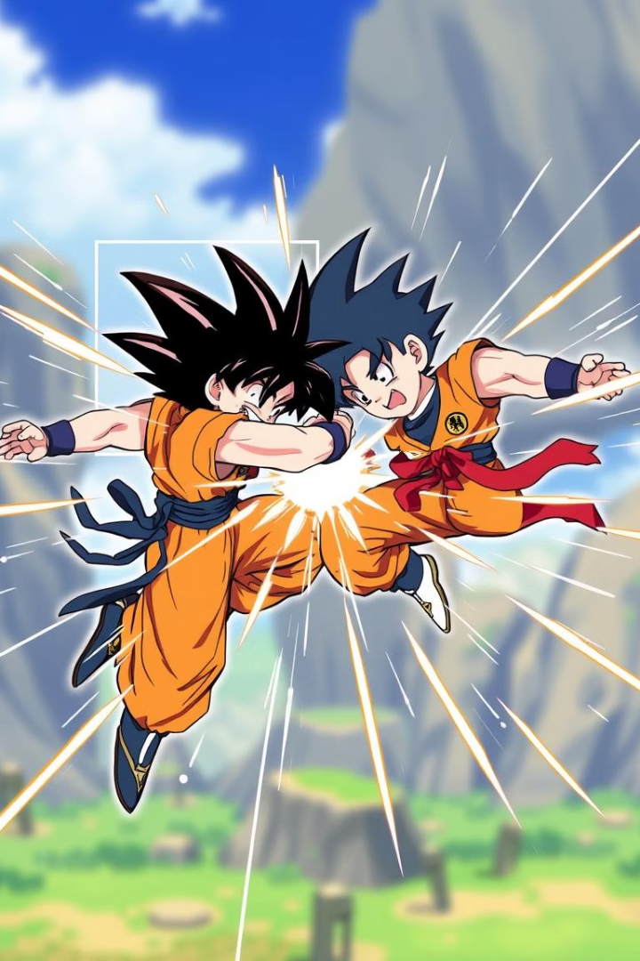
Collision Detection: Making it Real
CheckCollision Function
Collision Response
Determines collision between two sprites using bounding boxes.
Handles interaction outcomes like bounce or damage.
Overlap Calculation
Measures collision depth for nuanced responses.

Slide 9



Some other features
Animation Functions
Control positions and sprite
changes for smooth action.
2
SFML Window
Base for drawing characters and environment visuals.
1
Physics
3
Collisions and gravity simulate
realistic gameplay.

Slide 10
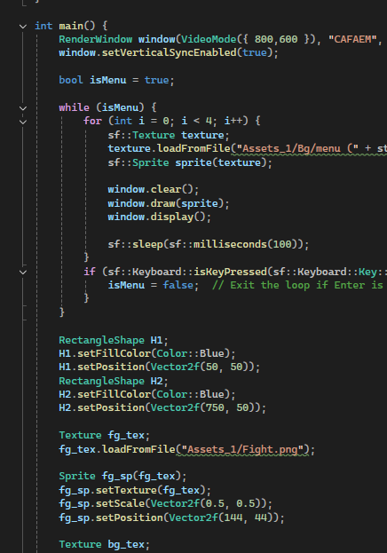
Animate Details and Sstream
Character Animations
Visual motion sequences bring characters to life.
Data Display
Use `stringstream` to show dynamic info like score and health.

Slide 11
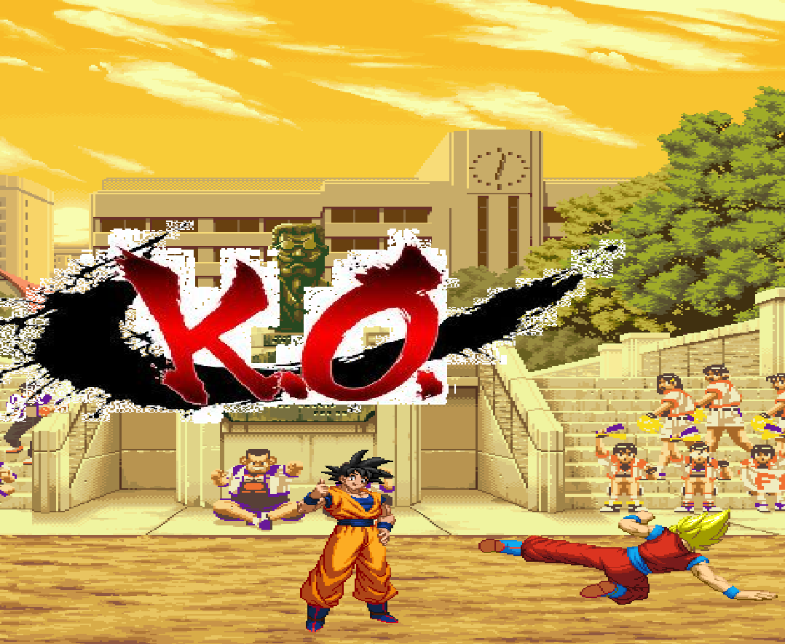
Conclusion to
CAFEAM
Review
CAFEAM combines C++ fundamentals with
SFML for game dev success.
Importance
Strong basics enable powerful multimedia and interactivity.

